Slide 1
Grow
Jonathan Haslow-Hall
David Winings
Eugene Raether
Special Thanks: Wes Boynton, Lucy Niedbala

Slide 2
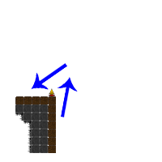
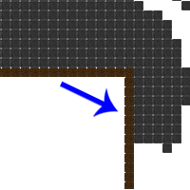
Adhesion

Slide 3
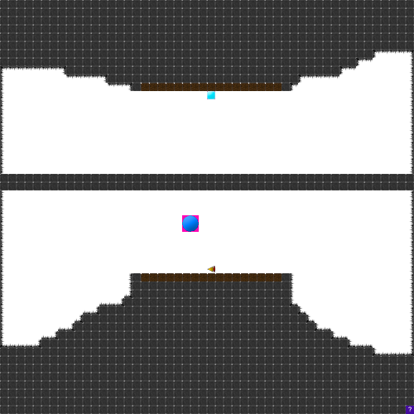
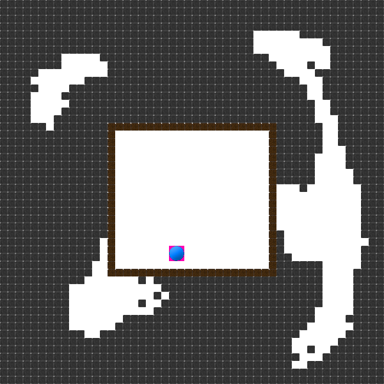
Levels that Teach
Levels designed to teach the player how to play the game

Slide 4
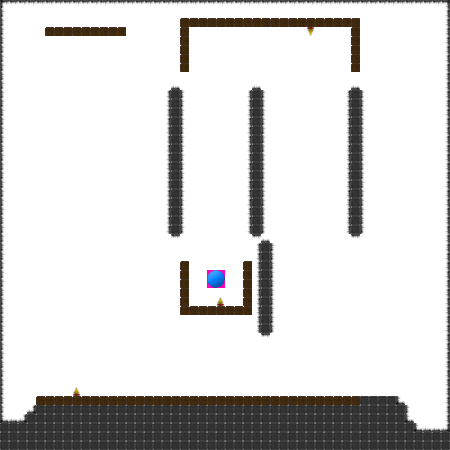
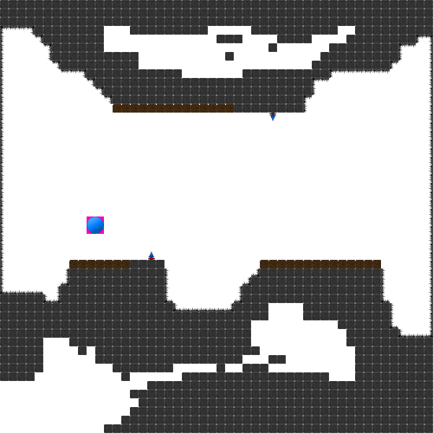
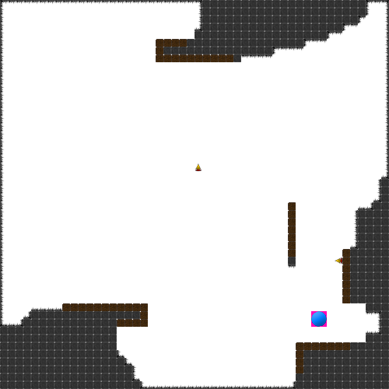
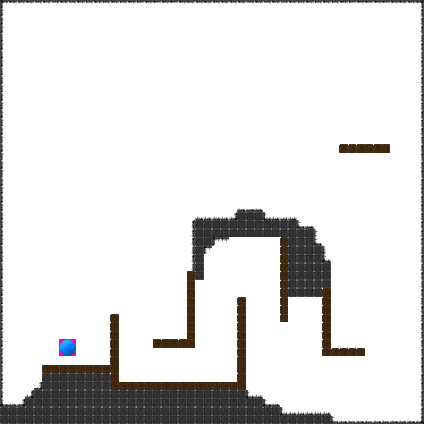
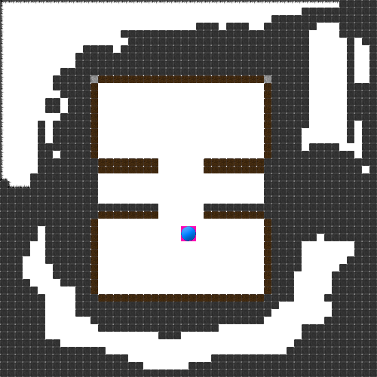
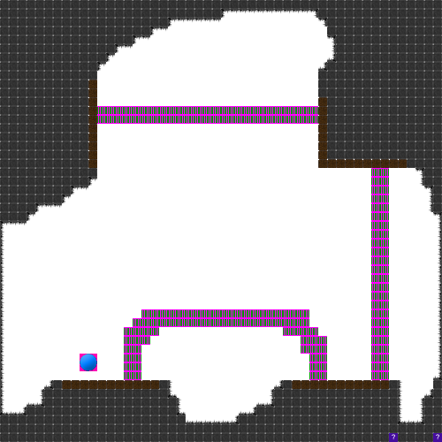
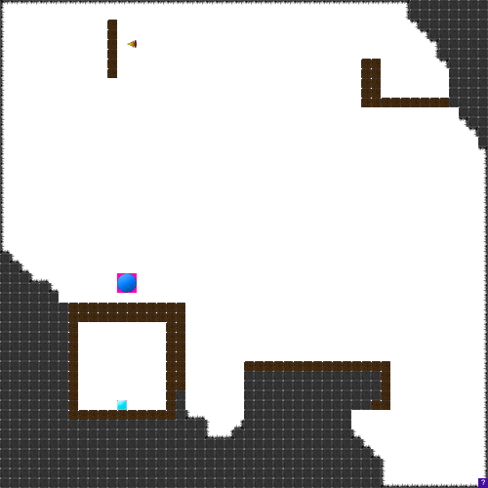
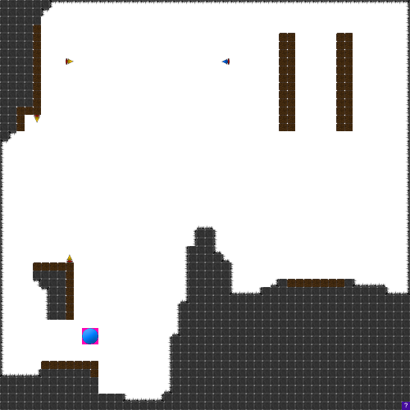
Tons of levels

Slide 5
Live Demo
Run Game

Slide 6
Biggest Challenge
Sounds
Debugging

Slide 7
Lessons Learned
GitHub is necessary
Set deadlines
Have lots of testers

Slide 8
Next?
More Maps
Bigger blocks
More blocks
Android

Slide 9
Resources
All done by us.

